Slide 1
Microsoft Fabric
Ian Pike, Senior Azure Technical Specialist

Slide 2






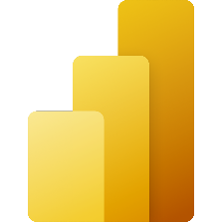


Microsoft Analytics Portfolio
Data Factory
Synapse DW
Purview
Event Hub
Data Explorer
Azure AI
Power BI
Synapse Spark
Azure Databricks

Slide 3


Quote
Introducing Microsoft Fabric
Microsoft Fabric enables you to manage your data in one place with a suite of analytics experiences that work together seamlessly, including:
Data Factory
Synapse Data Engineering
Synapse Data Warehouse
Synapse Data Science
Synapse Real-Time Analytics
Power BI
Data Activator

Slide 4
Quote
“
Simplify, I am the Chief Data Officer and don’t want to be the Chief Integration Officer.”
Every CDO, Every Enterprise

Slide 5

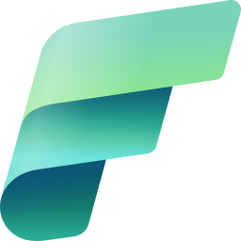
Announcing Microsoft Fabric
Announcing
Microsoft Fabric
Data analytics for the era of AI

Slide 6
Microsoft Fabric: Data analytics for the era of AI 1/5
Microsoft Fabric
Data analytics for the era of AI
Complete Analytics Platform

Slide 7
Microsoft Fabric: Data analytics for the era of AI 2/5
Microsoft Fabric
Data analytics for the era of AI
Complete Analytics Platform
Lake Centric and Open

Slide 8
Microsoft Fabric: Data analytics for the era of AI 3/5
Microsoft Fabric
Data analytics for the era of AI
Complete Analytics Platform
Lake Centric and Open
Empower Every Business User

Slide 9
Microsoft Fabric: Data analytics for the era of AI 4/5
Microsoft Fabric
Data analytics for the era of AI
Complete Analytics Platform
Lake Centric and Open
Empower Every Business User
AI Powered

Slide 10





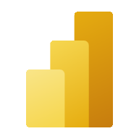


Microsoft Fabric: Data analytics for the era of AI 5/5
Microsoft Fabric
Data analytics for the era of AI
Data
Factory
Synapse Data
Engineering
Synapse Data
Science
Synapse Data Warehouse
Synapse Real Time Analytics
Power BI
Data Activator
OneLake

Slide 11
Microsoft Fabric
Data analytics for the era of AI
Complete Analytics Platform
Lake Centric and Open
Empower Every Business User
AI Powered
Everything, unified
OneLake
Familiar and intuitive
Copilot accelerated
SaaS-ified
One copy
Built into Microsoft 365
GPT on your data
Secured and governed
Open at every tier
Insight to action
AI-driven insights

Slide 12
Microsoft Fabric: Complete analytics platform
Microsoft Fabric
Data analytics for the era of AI
Complete Analytics Platform
Empower Every Business User
AI Powered
Complete Analytics Platform
Lake Centric and Open
Everything, unified
Everything, unified
OneLake
Familiar and intuitive
Copilot accelerated
SaaS-ified
SaaS-ified
One copy
Built into Microsoft 365
GPT on your data
Secured and governed
Secured and governed
Open at every tier
Insight to action
AI-driven insights

Slide 13
Microsoft Fabric
Microsoft Fabric
Single…
Data
Factory
Synapse Data
Engineering
Synapse Data
Science
Synapse Data Warehouse
Synapse Real Time Analytics
Data Activator
Onboarding and trials
Sign-on
Navigation model
UX model
Workspace organization
Collaboration experience
Data Lake
Storage format
Data copy for all engines
Security model
CI/CD
Monitoring hub
Data Hub
Governance & compliance
Power BI
AI Assisted
Shared Workspaces
Universal Compute Capacities
One Security
OneLake
Intelligent data foundation

Slide 14
SaaS
“It just works"
Success by default
Centralized administration
5x5
Frictionless onboarding
Minimal knobs
Tenant-wide governance
Instant provisioning
Auto optimized
Centralized security management
Quick results w/ Intuitive UX
Auto integrated
Compliance built-in

Slide 15
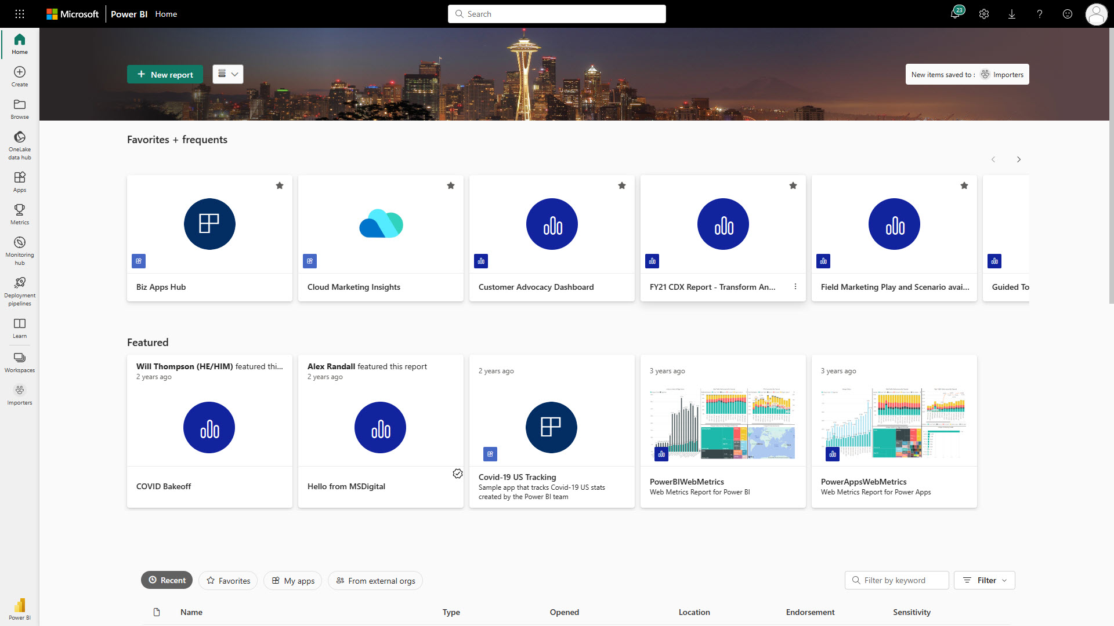
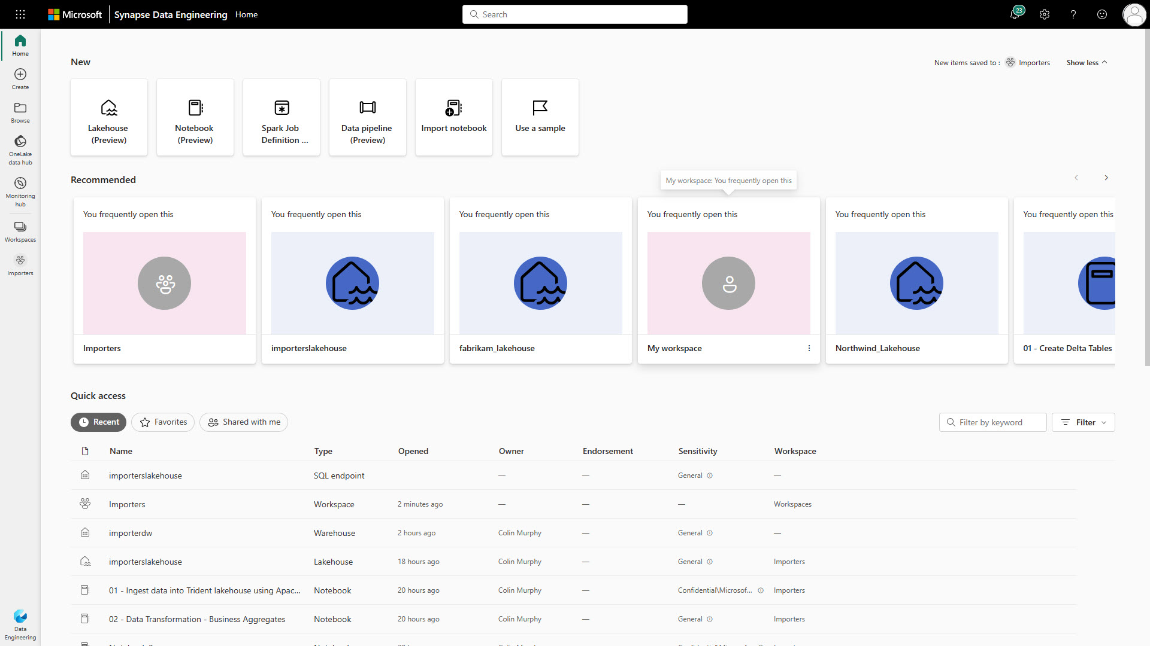
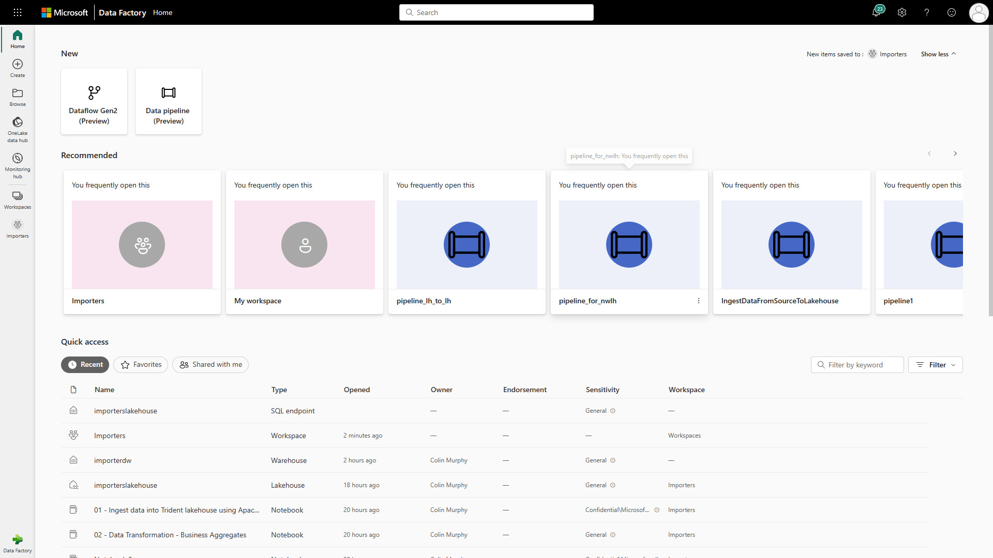
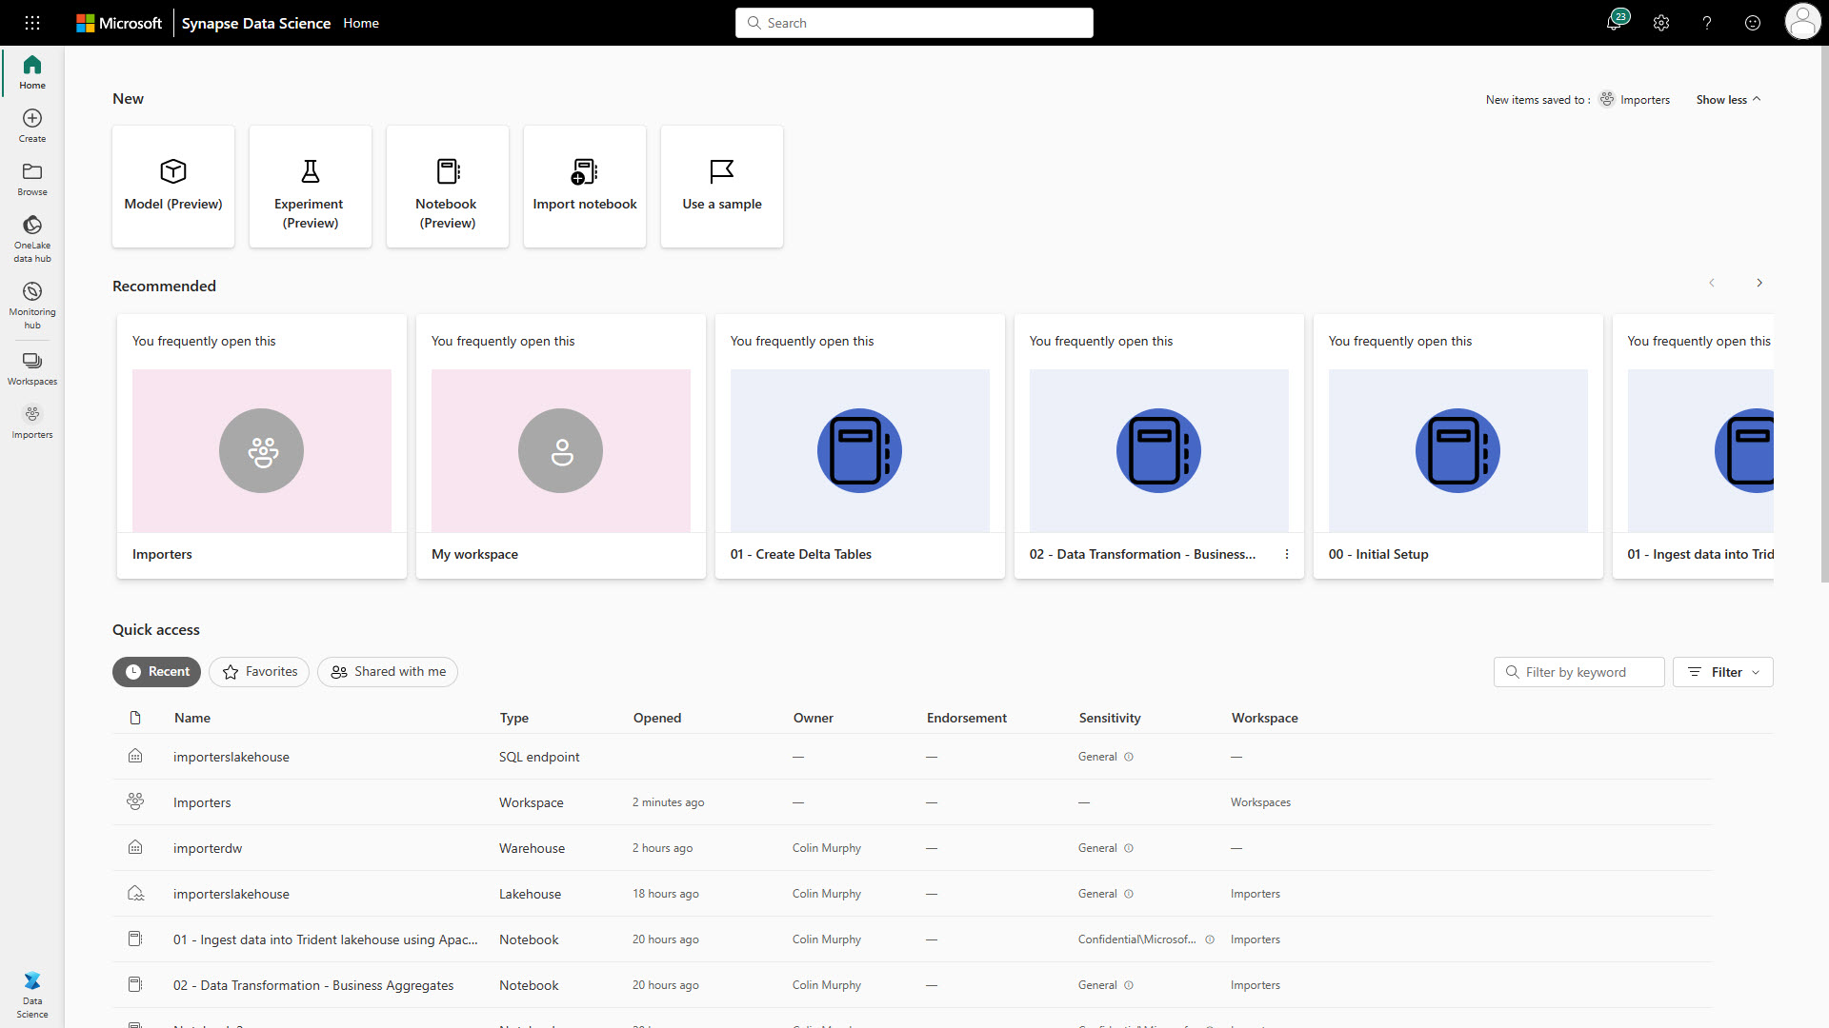
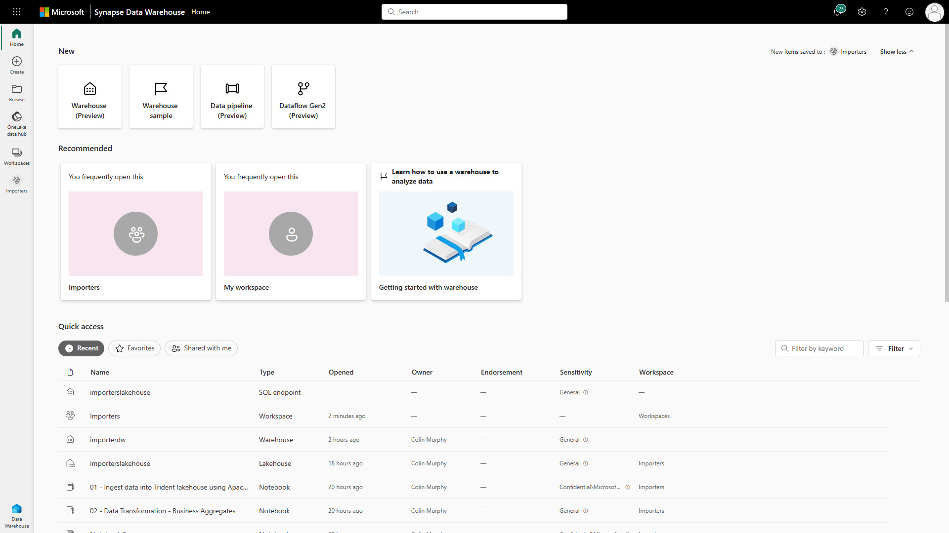
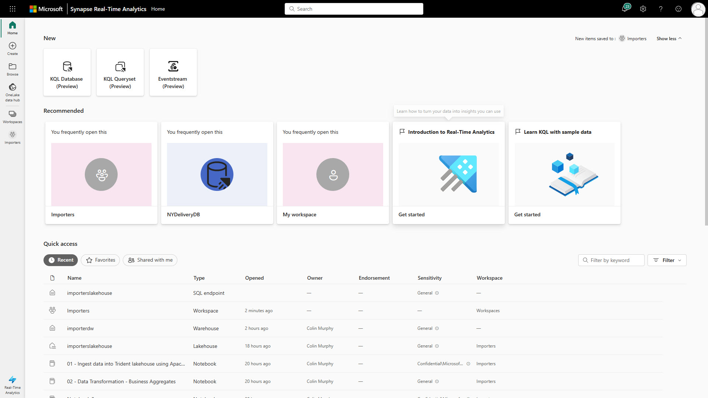
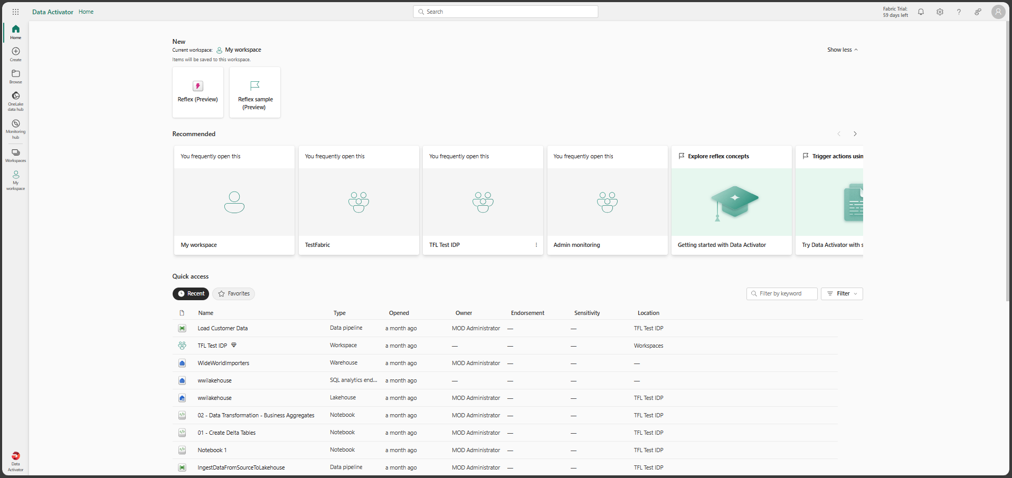



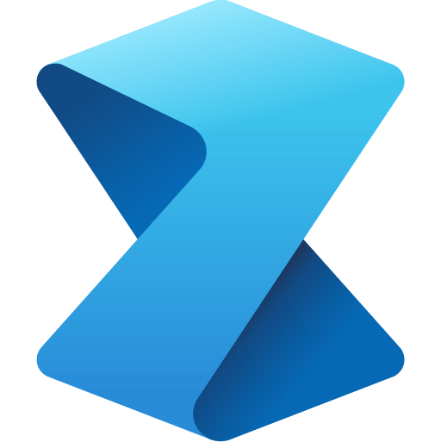


Persona optimized experiences

Slide 16









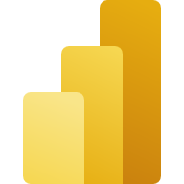


Fabric Personas
Data Engineers
Data Scientists
Data Analysts
Data Citizens
Execute faster with the ability to spin up a Spark VM cluster in seconds, or configure with familiar experiences like Git DevOps pipelines for data engineering artifacts
Streamline your work with a single platform to build and operate real-time analytics pipelines, data lakes, lake houses, warehouses, marts, and cubes using your preferred IDE, plug-ins, and tools.
Reduce costly data replication and movement with the ability to produce base datasets that can serve data analysts and data scientists without needing to build pipelines
Quickly tune a custom model by integrating a model built and trained in Azure ML in a Spark notebook
Work faster with the ability to user your preferred data science frameworks, languages, and tools
Bypass engineering dependencies with the ability to use your preferred no-code ML Ops to deploy and operate models in production
Tap into proven-at-scale models and services to accelerate your AI differentiation (AOAI, Cognitive Services, ONNX integration, etc).
Avoid slow, progress-stagnating data wrangling by seamlessly triggering a workflow that can unlock data engineering tools and capabilities quickly.
Accelerate your work with visual and SQL based tools for self-serve data transformations and modeling as well as self-serve tools for reporting, dashboards, and data visualizations
Turn data into impact with industry-leading BI tools and integration with the apps your people use everyday like Microsoft 365
Make more data-driven decisions with actionable insights and intelligence in your preferred applications
Maintain access to all the data you need, without being overwhelmed by data ancillary to your role thanks to fine grain data access management controls
Serve data via warehouse or lakehouse
Serve transformed data
Serve insights via embedding
Supporting experiences:
Supporting experiences
Supporting experiences
Supporting experiences
Data Factory
Data Warehouse
Data Science
Azure ML
Data Warehouse
Real-time analytics
Power BI
Power BI
Microsoft 365
Data Engineering
Real-time analytics
Serve data via warehouse or lakehouse
Data Stewards
Maintain visibility and control of costs with a unified consumption and cost model that provides evergreen spend optics on your end-to-end data estate
Gain full visibility and governance over your entire analytics estate from data sources and connections to your data lake, to users and their insights

Slide 17
Microsoft Fabric: Lake Centric and Open
Microsoft Fabric
Data analytics for the era of AI
Complete Analytics Platform
Lake Centric and Open
Empower Every Business User
AI Powered
Lake Centric and Open
Everything, unified
OneLake
OneLake
Familiar and intuitive
Copilot accelerated
SaaS-ified
One copy
One copy
Built into Microsoft 365
GPT on your data
Secured and governed
Open at every tier
Open at every tier
Insight to action
AI-driven insights

Slide 18
OneLake for all Data
“The OneDrive for Data”
A single SaaS lake for the whole organization
Provisioned automatically with the tenant
All workloads automatically store their data in the OneLake workspace folders
All the data is organized in an intuitive hierarchical namespace
The data in OneLake is automatically indexed for discovery, MIP labels, lineage, PII scans, sharing, governance and compliance
Data
Factory
Synapse Data
Engineering
Synapse Data
Science
Synapse Data Warehouse
Synapse Real Time Analytics
Data Activator
Power BI
OneLake
Intelligent data foundation

Slide 19
OneLake for all domains
A true data mesh across organization domains
Sales
Marketing
Finance
Introducing domains as an integral part of Fabric: A domain is a way to logically group together all the data in an organization relevant to an area or field, according to business needs
Data
warehousing
Data
engineering
Data integration
Data
science
Real-time
analytics
Business intelligence
Domains are defined with domain admins and contributors who can associate workspaces and group them together under a relevant domain
Federated governance can be achieved by delegating settings to domain admins, thus allowing them to achieve more granular control over their business area
Unified management and governance
OneLake
Domains simplify discovery and consumption of data across the organization, thus allowing business optimized consumption
Sales
Marketing
Finance
Workspace
POS sales
Certified
Workspace
online sales
Certified
Workspace
customer
Workspace
ads
Promoted
Workspace
expenses
Avoid data swamps by endorsing certain data as certified or promoted, thus encouraging reuse.
Notes:
Different business groups are now able to work independently within the same data lake without the overhead of managing different storage resources. They are already able to implement the popular data mesh pattern more efficiently than they could before. OneLake takes this even further with the introduction of domains as a first-class concept. A single business domain may have multiple workspaces as workspaces tend to align with specific projects or teams.
A domain is a way of logically grouping together all the data in and organization that is relevant to an area or field.
Domains are defined with domain admins and contributors who can logically group together workspaces under those domains..
Domains provide a management boundary between tenant and workspace enabling admins to have more granular control over multiple workspaces.
As you will see later, domains also simplify discovery and consumption of data across the entire organization. Now that we are making it so easy for different parts of the organization to work on the same data lake without going through a central gatekeeper, you might be thinking that you want to block certain users from adding to the lake. If anyone can add to the data lake, then these can quickly become data swamps with data from official sources mixed with data from unofficial sources. The problem with blocking users from OneLake, is that they will just create another data lake somewhere else. When they do that, you will have no idea if that data is properly governed or even how it is being used. If they add their data to OneLake, it will be automatically governed and still under the control of the admins who will start to get more and more insights on how that data is being used.
You can avoid data swamps in OneLake through data endorsements. Domain owners can officially certify data or recommend data so that the important data rises to the surface while the rest sinks to the bottom.

Slide 20
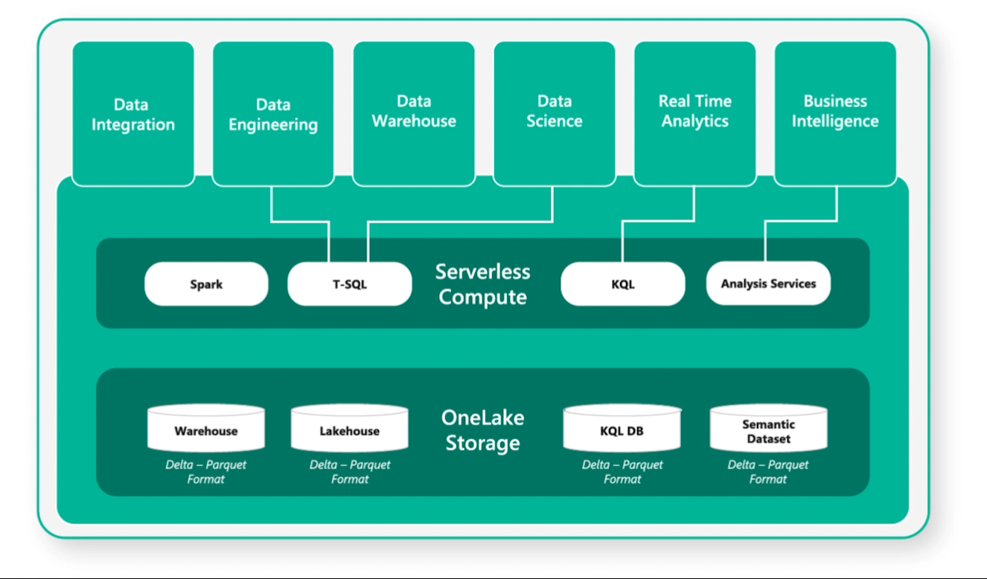
One copy for all computers
Real separation of compute and storage
All the compute engines store their data automatically in OneLake
The data is stored in a single common format
Delta – Parquet, an open standards format, is the storage format for all tabular data
Once data is stored in the lake, it is directly accessible by all the engines without needing any import/export
All the compute engines have been fully optimized to work with Delta Parquet as their native format
Shared universal security model is enforced across all engines
Notes:
Colin to add notes

Slide 21




Shortcuts
Shortcuts unify data without copying
or moving existing data
This means that data can be used multiple times
without data duplication.
Synapse Data
Science
Synapse Data Warehousing
Data
Factory
Synapse Data
Engineering
Synapse Real Time Analytics
Power BI
Data Activator
OneLake
Key Capabilities:
Create shortcuts within Microsoft Fabric to consolidate data across artifacts or workspaces, without changing ownership of the data
With shortcuts, data throughout OneLake can be composed together without any data movement
Shortcuts also allow instant linking of data already existing in Azure and in other clouds, without any data duplication and movement, making OneLake the first multi-cloud data lake
With support for industry standard APIs, OneLake data can be directly accessed by any application or service
Customers 360
Finance
Service Telemetry
Business KPIs
Azure
Amazon
Google

Slide 22
Common analytics scenarios
Lakehouse
Data Warehouse
Data Science
Real Time Analytics
Notes:
Microsoft Fabric supports four common end-to-end analytics scenarios:
Lakehouse
Data Warehouse
Data Science
Real Time Analytics
Keep in mind that while these are the most common scenarios supported by Microsoft Fabric, there are many others that technical and business end-users can navigate through.

Slide 23
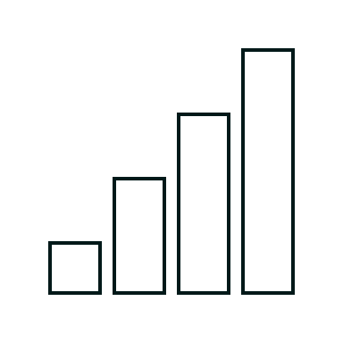
Lakehouse scenario
End-to-end analytics scenario
Data Source
Ingestion
Store
Expose
Shortcut Enabled
Shortcuts
Lakehouse(s)
Business Intelligence
Structured / Unstructured
Pipelines & Dataflows
SQL endpoint
Transform
Notebooks & Dataflows

Slide 24
Data warehouse scenario
End-to-end analytics scenario
Data Source
Ingestion
Store
Expose
Structured
Pipelines & Dataflows
Data Warehouse
Business Intelligence
Warehouse
Transform
Procedures

Slide 25
Data science scenario
End-to-end analytics scenario
Data Source
Clean & prepare
Store
Expose
Lakehouse & Data Warehouse
Notebooks
Lakehouse(s)
Business Intelligence
Train test & apply
SQL endpoint
Experiments
Models
Notes:
Data Science in Fabric brings ML professionals into the platform. In turn, this enables collaboration with the other stakeholders already there. Data scientists are thus empowered to enrich organizational data with predictions, meaning business analysts can incorporate those into BI reports, shifting the insights from descriptive to predictive.

Slide 26
Real-time analytics scenario
End-to-end analytics scenario
Data Source
Ingestion
Store
Expose
Lakehouse & Data Warehouse
CI & Shortcuts
Kusto DB
Business Intelligence
Structured / Unstructured
Pipeline & Dataflows
Kusto Query
Event Streaming
Mirror
Notebook
Lakehouse & Data Warehouse
ML Model

Slide 27
Microsoft Fabric: Empower Every Business User
Microsoft Fabric
Data analytics for the era of AI
Empower Every Business User
Complete Analytics Platform
Lake Centric and Open
Empower Every Business User
AI Powered
Everything, unified
OneLake
Familiar and intuitive
Familiar and intuitive
Copilot accelerated
SaaS-ified
One copy
Built into Microsoft 365
Built into Microsoft 365
GPT on your data
Secured and governed
Open at every tier
Insight to action
Insight to action
AI-driven insights

Slide 28
Announcing Data Activator
Announcing
Data Activator

Slide 29
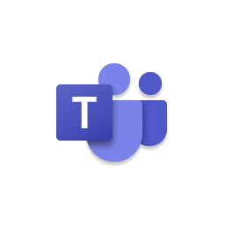

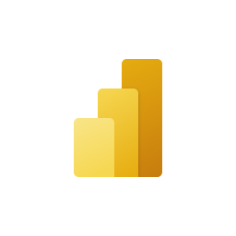


Introducing Data Activator
OneLake
Teams
Outlook
Power BI
Data Activator
Synapse Data Warehouse
No-code user experiences
Power Automate
Synapse Real Time Analytics
Custom
Models
Rules
Triggers
…
Real-time stream processing
…

Slide 30

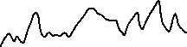
Patterns over time
Greater than a threshold
“Alert me when the number of support calls exceeds 100 on any given day.”
Crosses above a threshold
“Alert an account manager upon any invoice becoming 10 days overdue.”
Crosses above and stays above
“File a ticket upon any freezer crossing and staying above 32F for 15 minutes.”
Crosses above 3 times in an hour
“File a ticket whenever any freezer exceeds 32F three times in an hour.”
Decreases by 10
“Alert the product manager when revenue decreases by $10k in one day.”
Decreases by 10%
“Alert the product manager when revenue decreases by 10% in one day.”
Rolling average decreases by 10%
“Alert when the 6-hour rolling average of sensor readings decreases by 10%.”
Exceeds 1 standard deviation
“Alert when sensor readings are is one stdev outside of 7-day rolling average.”
Notes:
I just showed you how Reflex can detect a value going above a threshold. And Reflex will detect not just threshold conditions, but many types of patterns over time. It will all be accessible through that simple, no-code experience that you’ve just seen.

Slide 31
Microsoft Fabric: AI Powered
Microsoft Fabric
Data analytics for the era of AI
Empower Every Business User
AI Powered
Complete Analytics Platform
Lake Centric and Open
AI Powered
Everything, unified
OneLake
Familiar and intuitive
Copilot accelerated
Copilot accelerated
SaaS-ified
One copy
Built into Microsoft 365
GPT on your data
GPT on your data
Secured and governed
Open at every tier
Insight to action
AI-driven insights
AI-driven insights

Slide 32
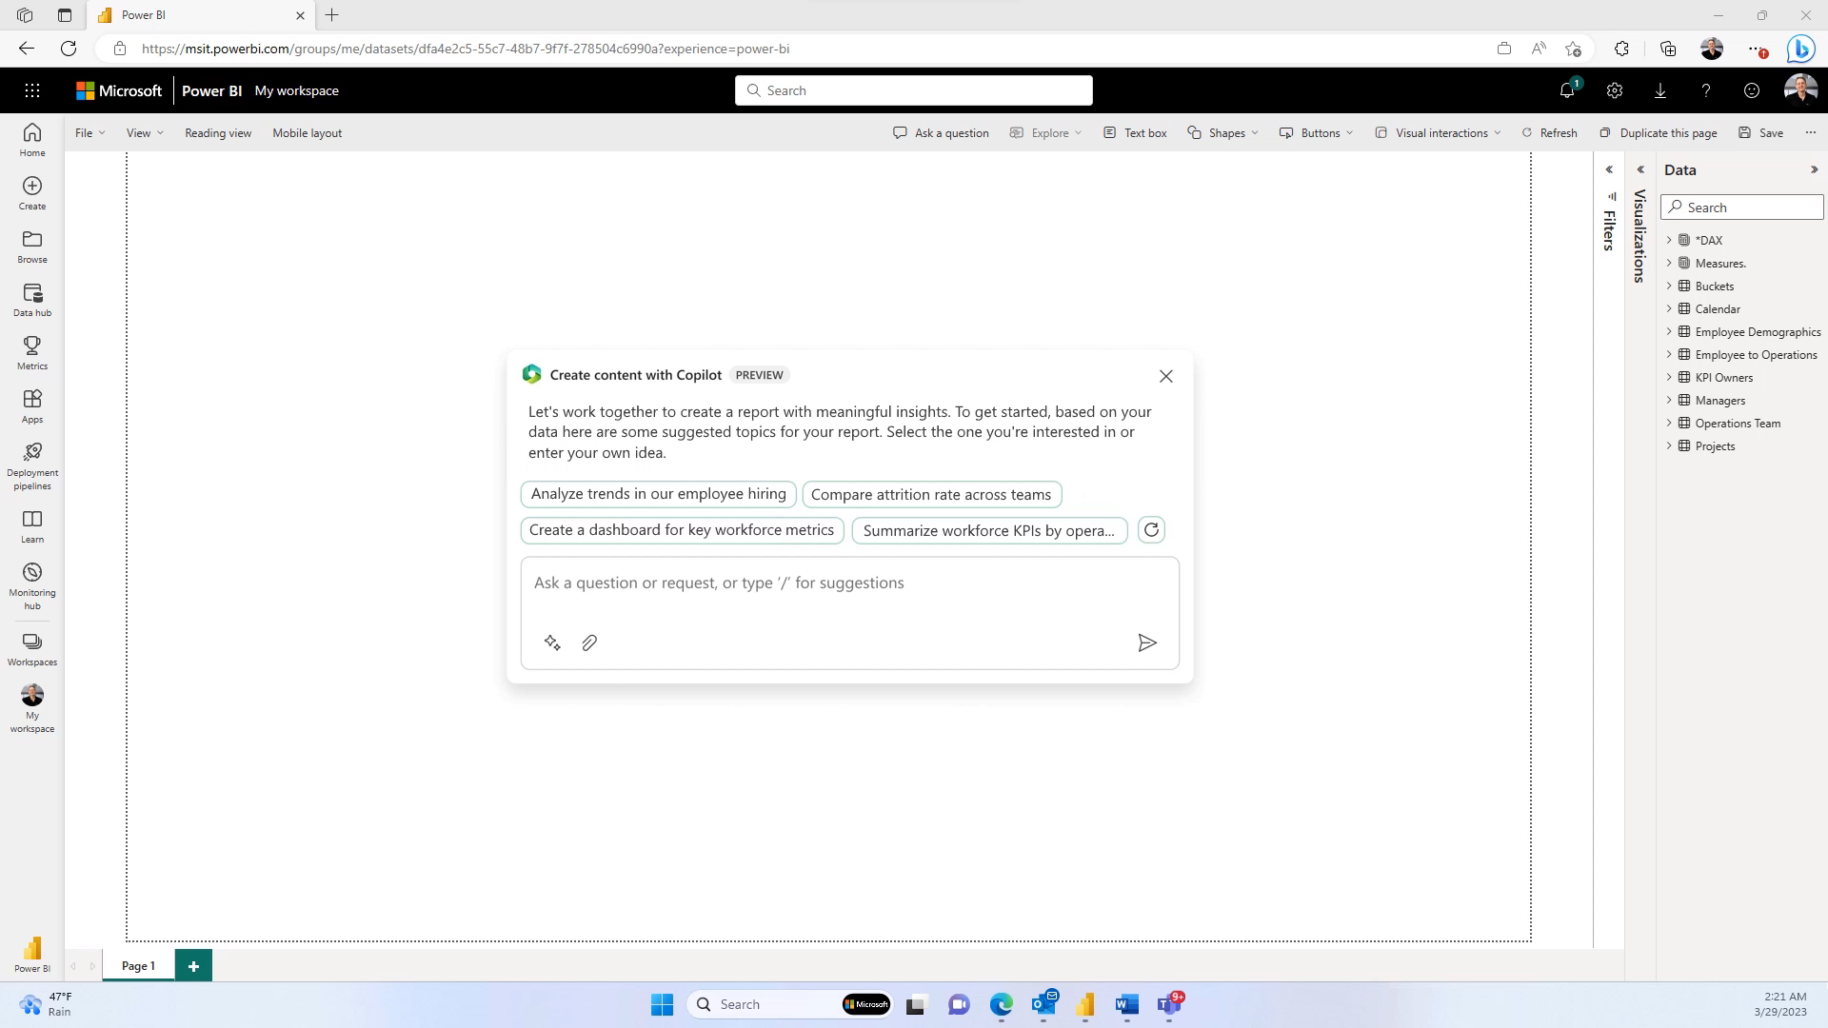

Slide 33

Available now (9th Nov 2023)
Public preview
Generally available
Data Factory
Synapse Data Engineering
Synapse Data Science
Synapse Data Warehousing
Synapse Real Time analytics
Copilot for Power BI (DAX)
OneLake
Data Activator
Power BI
Private preview
Copilot for Microsoft Fabric
Copilot for Power BI (full)

Slide 34
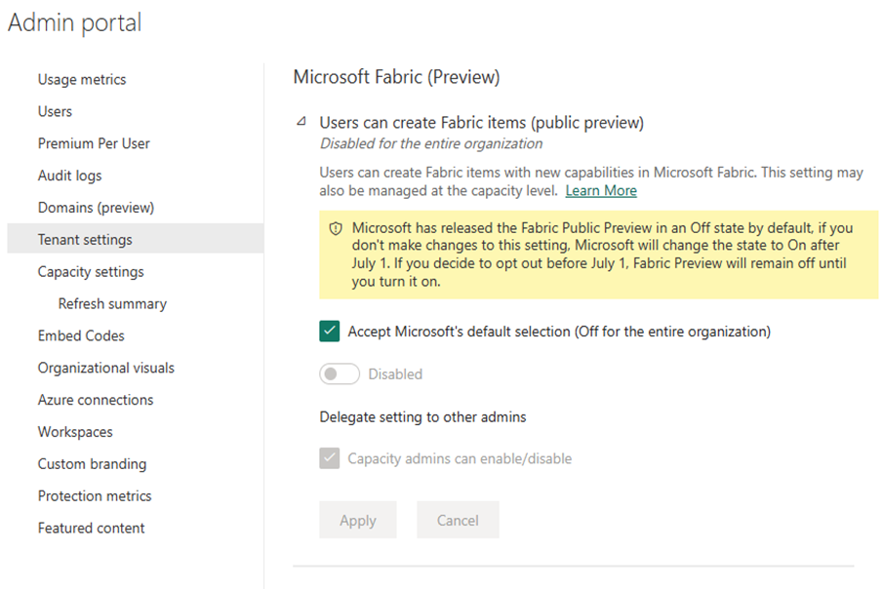

Fabric preview setting
Notes:
Let’s take a quick look at a new tenant setting that allows you (an admin) control availability of Fabric preview for users within your tenant. Fabric preview will be OFF by default for your tenant at launch and in early July, we will make this ON by default unless you choose to not follow Microsoft’s default and explicitly opt-out.
Additionally, this setting can also be configured per capacity independent of the configuration at the tenant level.

Slide 35
“Direct Query Mode”
Parquet/Delta Lake
Data
Warehouse/
Lakehouse
Power BI
Dataset
Scan
SQL
Queries
DAX
Queries
Tables
Reports
Slow, but real time
OneLake
“Import Mode”
Parquet/Delta Lake
Data
Warehouse/
Lakehouse
Power BI
Dataset
DAX
Queries
Scan
Import
Latent & duplicative but fast
Tables
Reports
OneLake
Copy of
Tables
Notes:
Direct Lake, personally this is my favourite new feature that comes with fabric.
Until now, dataset creators had to choose between Import and DirectQuery mode when accessing data.
Import mode delivers fast performance but Power BI must first copy the data during refresh. Any changes at the source are only picked up with the next data refresh. This came with limitations.
DirectQuery mode however avoids having to copy data, but typically suffers performance degradation by having to submit federated queries that end up going to other database systems that are not as efficient for BI-style queries.

Slide 36
“Direct Query Mode”
Parquet/Delta Lake
Data
Warehouse/
Lakehouse
Power BI
Dataset
Scan
SQL
Queries
DAX
Queries
Tables
Reports
Slow, but real time
OneLake
“Import Mode”
Parquet/Delta Lake
Data
Warehouse/
Lakehouse
Power BI
Dataset
Scan
Import
DAX
Queries
Latent & duplicative but fast
Tables
Reports
OneLake
Copy of
Tables
“DirectLake Mode”
Parquet/Delta Lake
Data
Warehouse/
Lakehouse
Power BI
Dataset
Scan
DAX
Queries
Perfect!
Tables
Reports
OneLake
Notes:
Direct Lake mode combines the advantages of Import mode and DirectQuery without picking up those disadvantages: the query performance is on par with Import without having to copy data or manage those refreshes.
Direct Lake is a fast way to query data directly from the lake for your Lakehouse or Warehouse. The data volumes for Direct Lake mode far exceed the per-dataset memory limits for Import models currently in Power BI Premium Gen2.
Building near real-time BI solutions to unlock massive data with this approach has never been easier.
All you would need to do. Is Just go to your Lakehouse or Warehouse in Fabric, click on the New Power BI Dataset button, select the tables you want to include, and click Confirm. Open the data model to create measures and relationships as you would for any other Power BI dataset. Lastly click the new report button and create beautiful Power BI reports! Note the integrated experience from data in the lake through to report creation without leaving the browser or performing a refresh!
By Using One Lake and storing parquet delta files only. The result of compression means that those same files can be used across all the different fabric workloads.
So the dame data files can be used in Data Factory or synapse or power bi. Which strongly reflects the approach to develop a one stop shop for analytics.

Slide 37
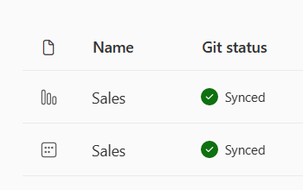
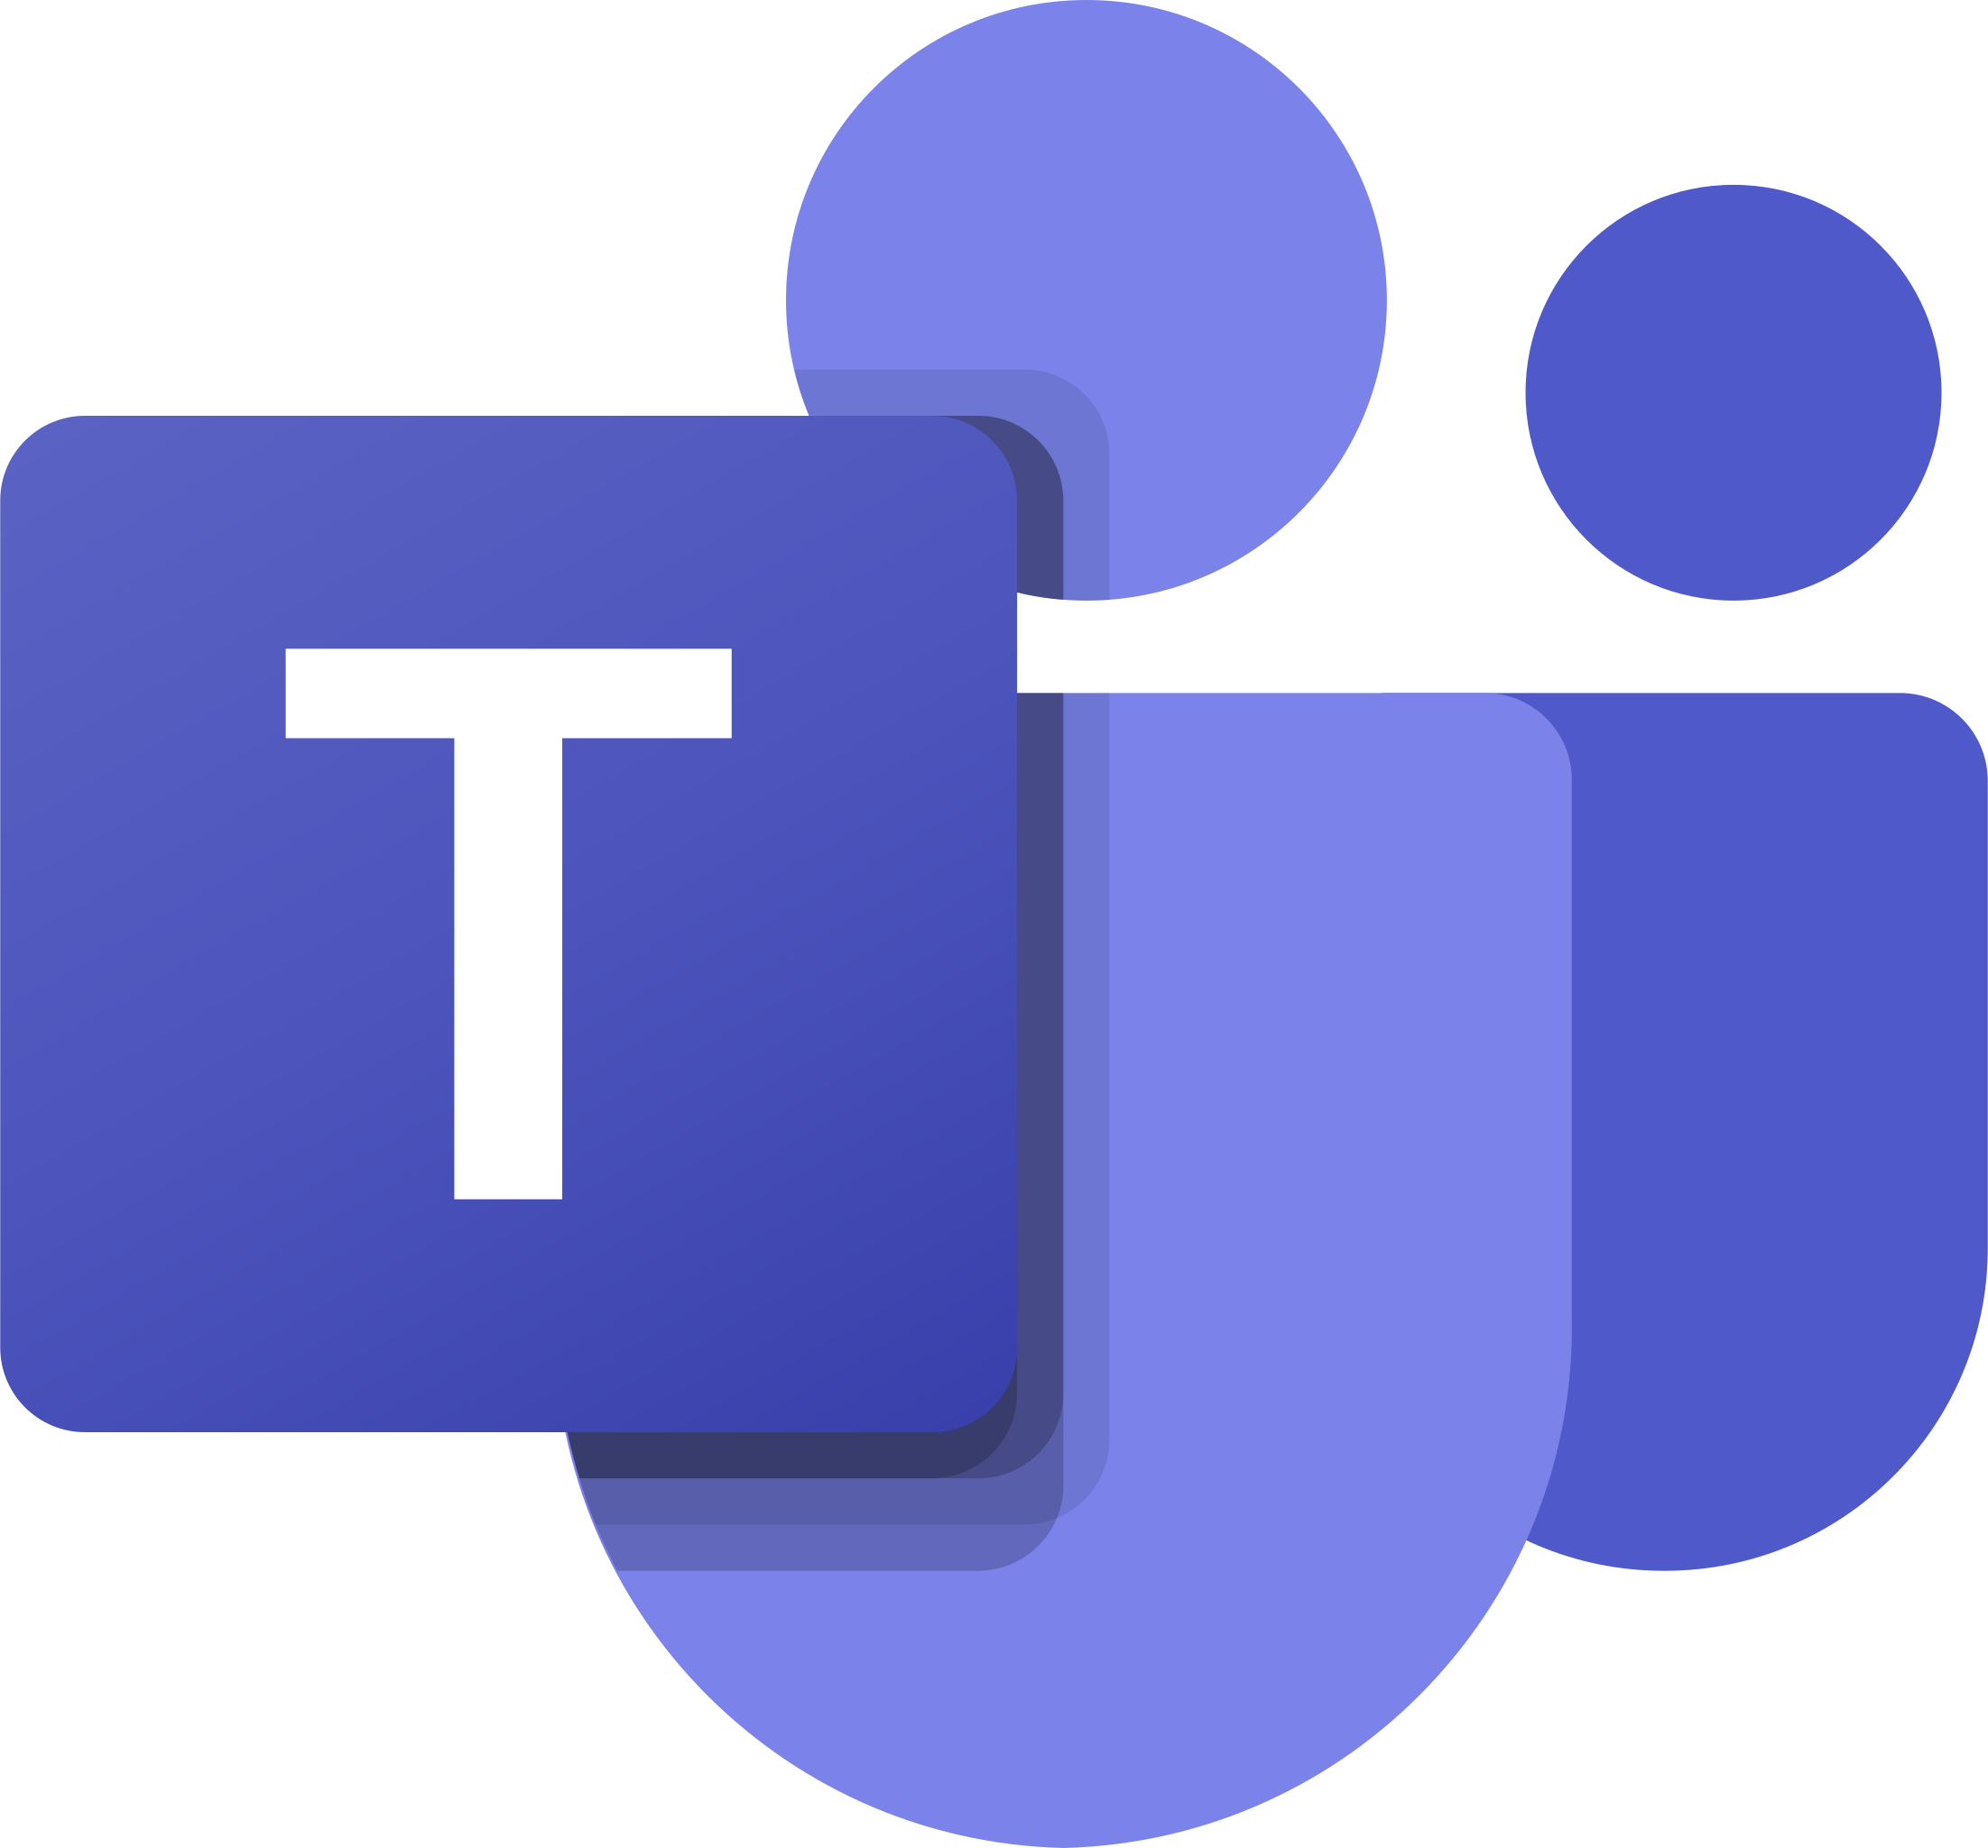
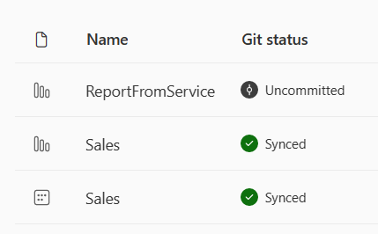


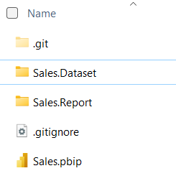
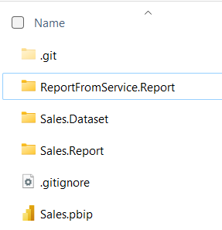
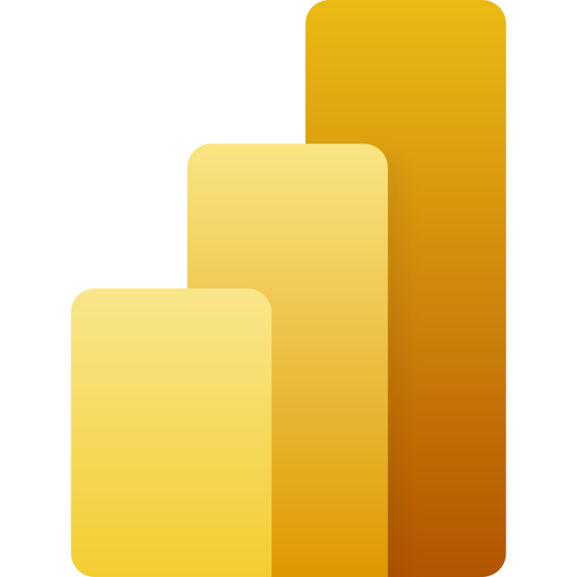

Developer experiences
Power BI Desktop Developer Mode with Trident Git Integration
Fabric
Client Apps
edit
Service APIs
Workspace
Git Integration
“commit to Git”
Git Host
“update from Git”
Azure
DevOps
open
Local Machine
git push
git pull
Local Folder
save
git commit
Power BI
Desktop
open
git checkout
Git Repo
(local)

Slide 38
Translation for existing Power BI Premium per capacity Customers
COMPUTE
Power BI Premium P SKUs get access to the full Fabric capabilities
8 CUs are providing the same compute power of 1 Power BI Premium v-core for Power BI workloads. That is, F64 provides the equivalent compute power of Power BI Premium P1
Today
Microsoft Fabric Public Preview
SKU | PBI vCore
P1 | 8
P2 | 16
P3 | 32
P4 | 64
P5 | 128
SKU | CU
F 64 | 64
F 128 | 128
F 256 | 256
F 512 | 512
F 1024 | 1024
Notes:
Power BI Premium capacity customers pay the same monthly price, and now have access to the all the new analytics workloads as part of Fabric.
The compute unit that powers all these capabilities is changing from a Power BI vCore to Capacity Unit (CU). 1 PBI vcore is = to 8 CUs, so P1 SKU which has 8 vCores will convert to an F 64 vCore with 64 CUs, and all the PBI workloads consume the same capacity as they did before Fabric.
We are also maintaining the 100 TB of storage for Power BI artifacts. For all the new Fabric artifacts, customers will need to provision OneLake storage for those new workloads.

Slide 39
Available today: Microsoft Fabric
Key Takeaways
Its not GA yet… (sign up to Ignite 😉) : https://register.ignite.microsoft.com/
Roadmap is available : Announcing the Fabric Roadmap | Microsoft Fabric Blog | Microsoft Fabric
See the latest announcements in the Microsoft Fabric blog site: https://aka.ms/fabric-tech-blog
Read the implementation guide: https://aka.ms/Getting-Started-eBook

Slide 40
End-to-end tutorials
Lakehouse tutorial
https://learn.microsoft.com/en-us/fabric/data-engineering/tutorial-lakehouse-introduction
Data Science tutorial
https://learn.microsoft.com/en-us/fabric/data-science/tutorial-data-science-introduction
Real-Time Analytics tutorial
https://learn.microsoft.com/en-us/fabric/real-time-analytics/tutorial-introduction
Data warehouse tutorial
https://learn.microsoft.com/en-us/fabric/data-warehouse/tutorial-introduction
Power BI tutorial
https://learn.microsoft.com/en-us/power-bi/fundamentals/fabric-get-started
Data Factory tutorial
https://learn.microsoft.com/en-us/fabric/data-factory/tutorial-end-to-end-introduction

Slide 41
Available today: Microsoft Fabric
Any Questions?
Microsoft Fabric
Live digital event aka.ms/BuildWithAnalytics

